Slide 1
PPT on Docker .
By Himanshu Singh

Slide 2
What is Docker ?
It is containerization tool used to create Container.
It is open-source.
It is used to create deploy and run the application.
It uses container on the host os to run the applications.
Docker container is not isolated with your host os resources-wise.
That means we can say docker is a tool which performs the os level virtulization.
Os level virtulization is also known as containerization in docker.
Docker is written in GO language.
It was first release in march 2013.

Slide 3
Advantages of Docker.
No pre allocation of the RAM.
It is also used in CI/CD pipeline.
It is less costly.
It is lighet weighted.
It can run on the physical h/w or on the cloud also.
It can reuse the docker image.
It takes very low time to create a container.

Slide 4
Dis-advantages of the Docker.
Difficult to manage the large number of the containers.
It is not rich in GUI.
It does not support cross-platform.
In this there is no data recovery(by-default).
container:-
It is just like instance of your docker image.
Note :- 1 . Docker image is analogeous to AMI.
2 . AMI==amazon machine image.

Slide 5
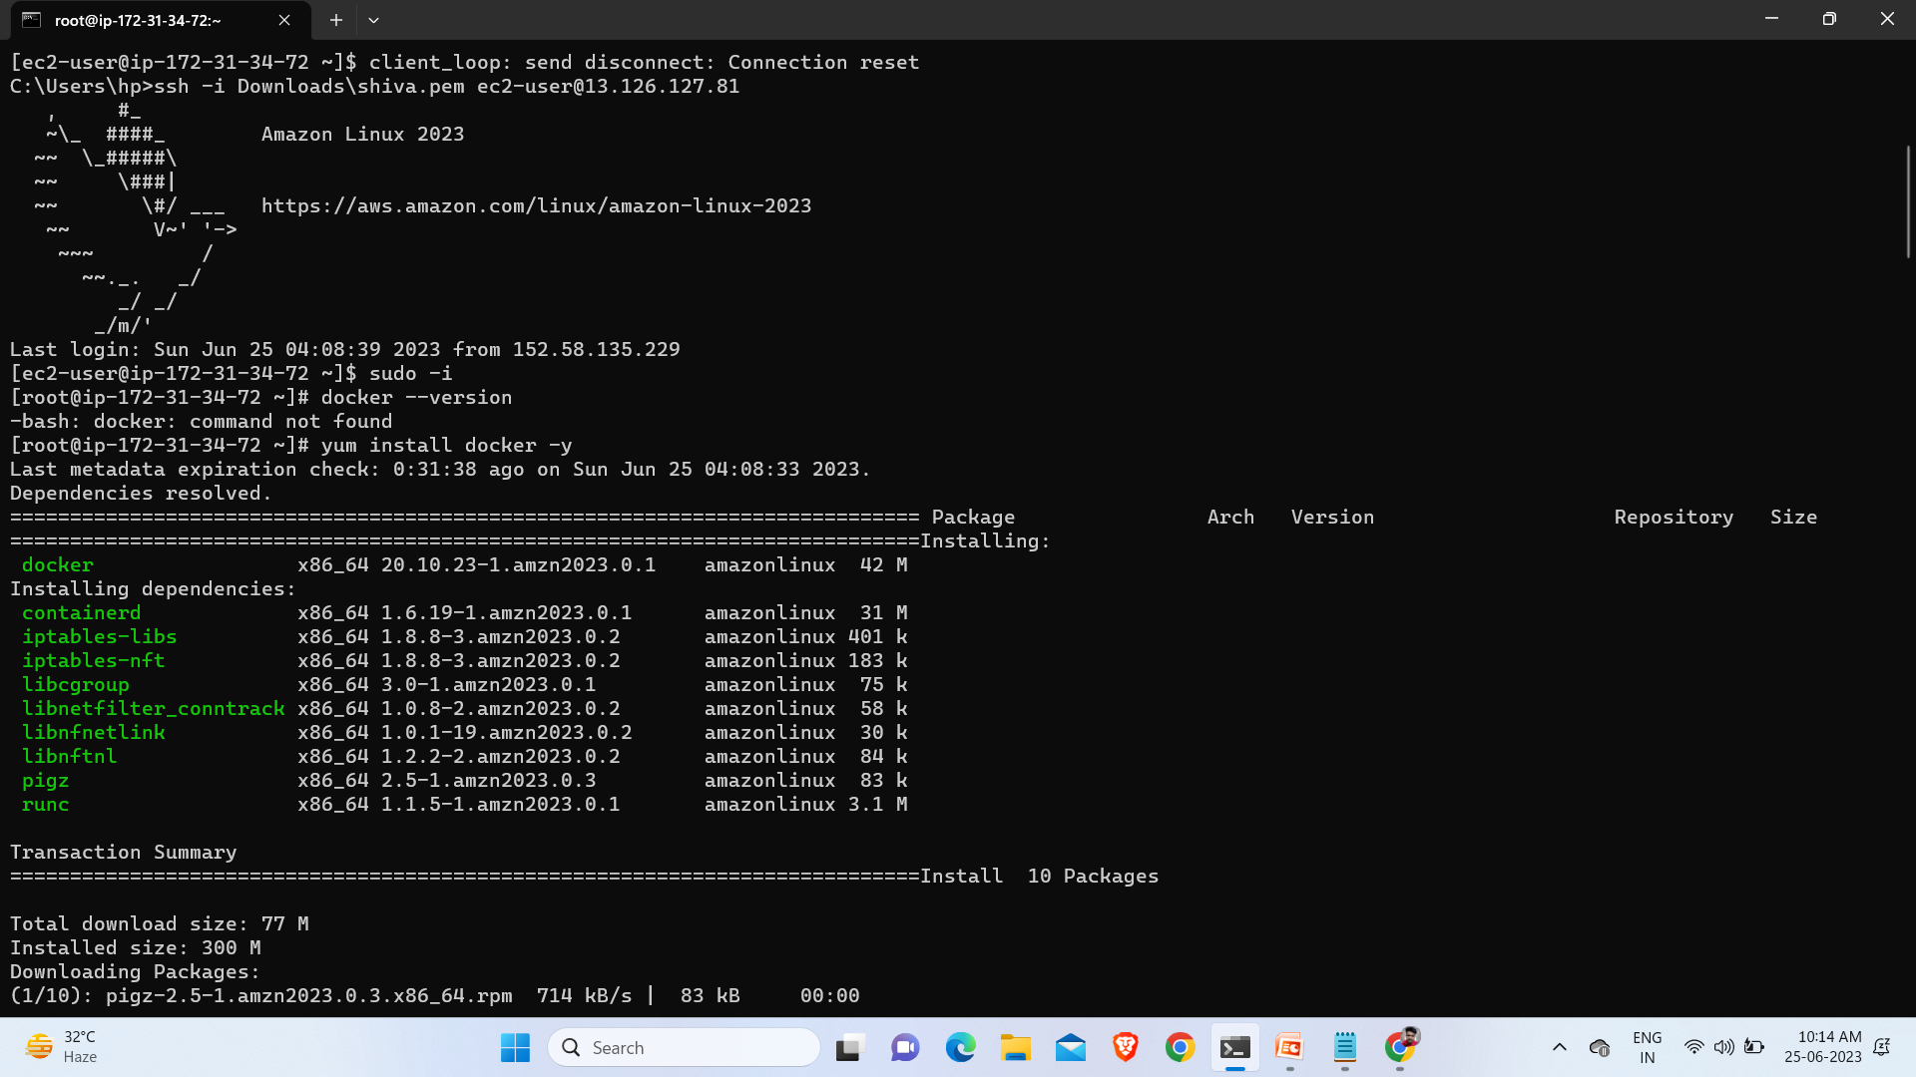
docker –version :- To check weather docker present or not.
yum install docker -y :- to install docker.

Slide 6
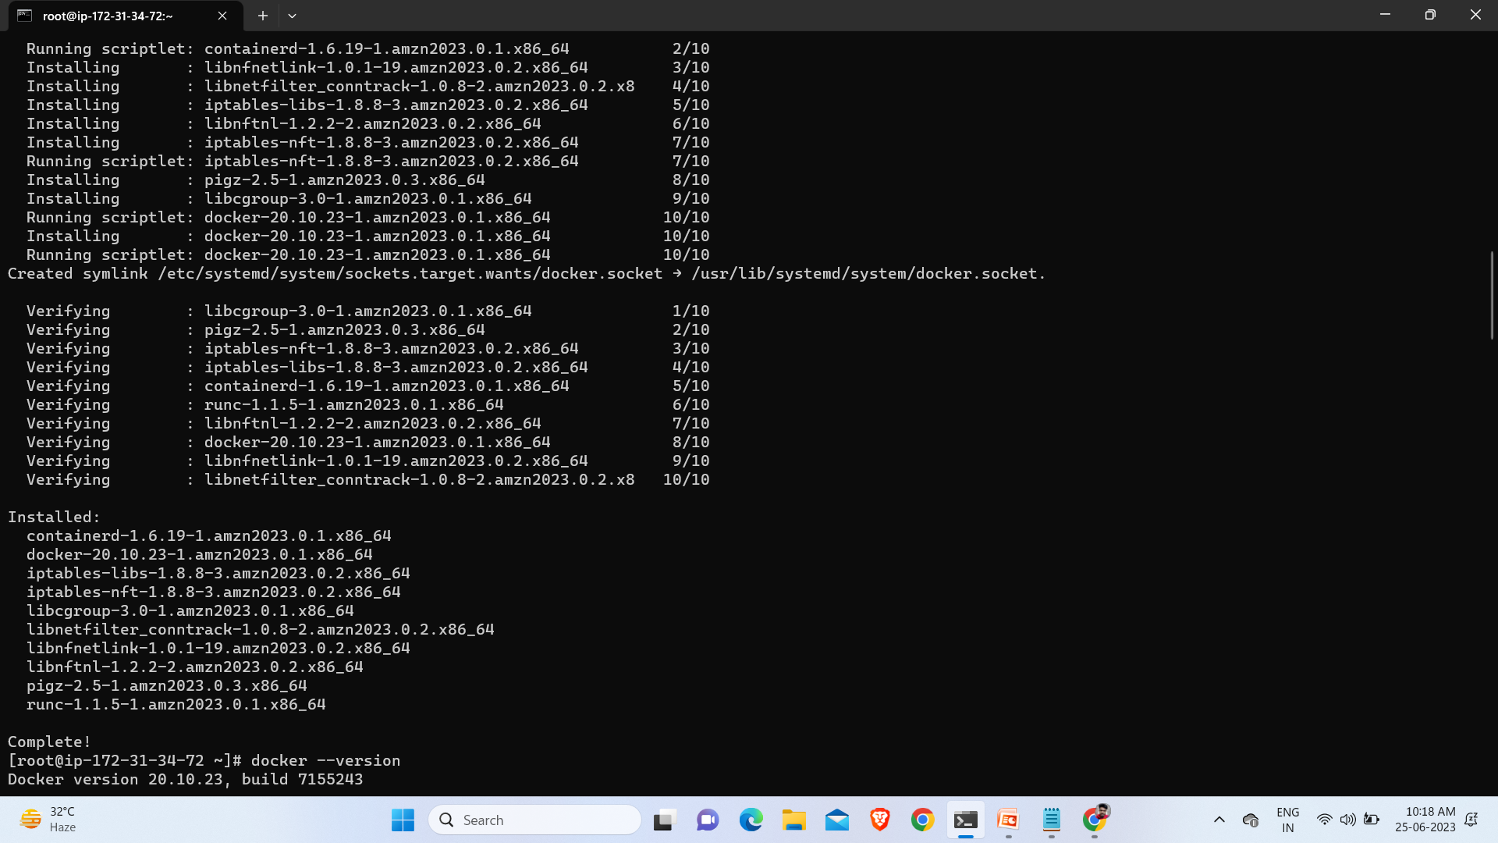
docker --version :- it will show the version of docker.

Slide 7
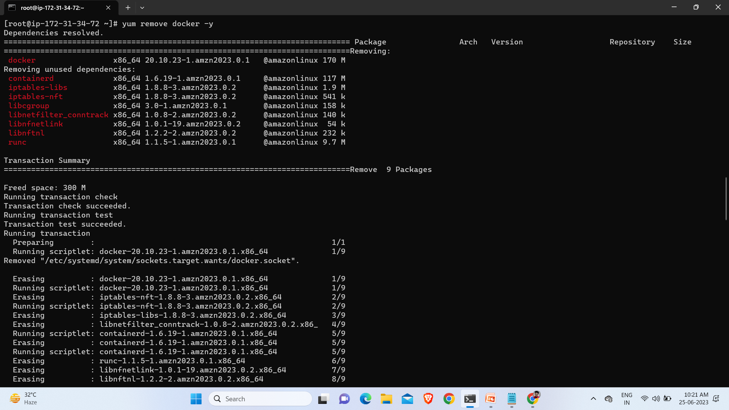
yum remove docker -y :- to remove the docker.

Slide 8
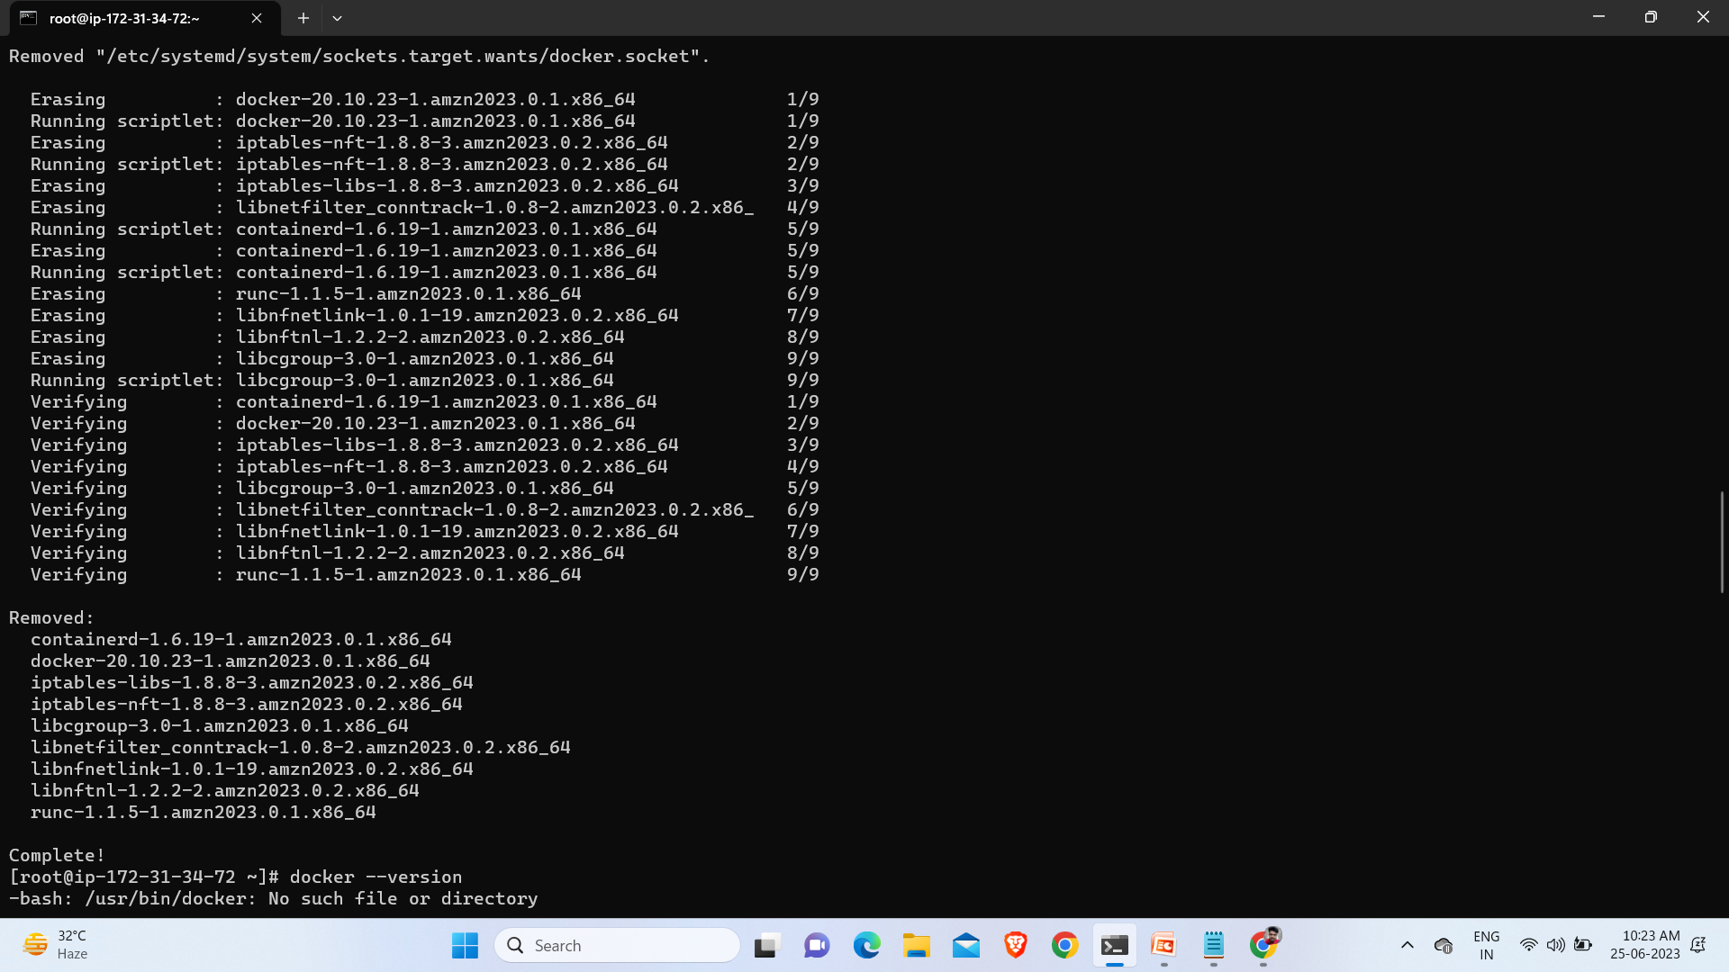
Now docker is removed from your machine.

Slide 9
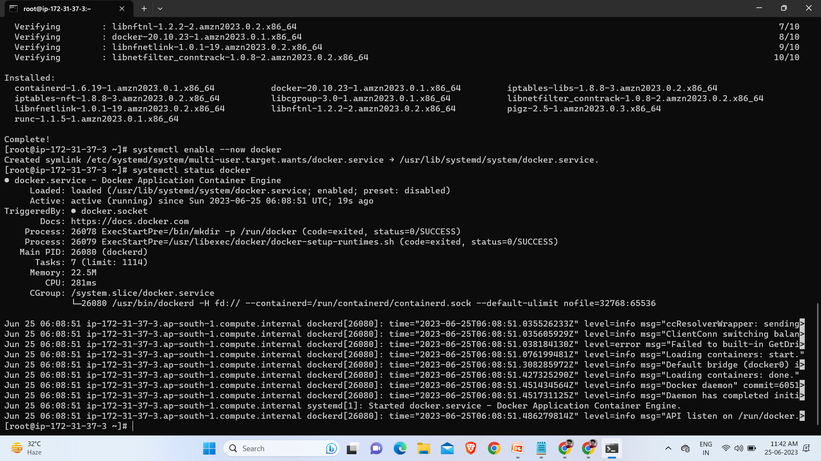
systemctl enable --now docker :- to start the docker.
systemctl enable --now docker :- to Active the Docker.

Slide 10
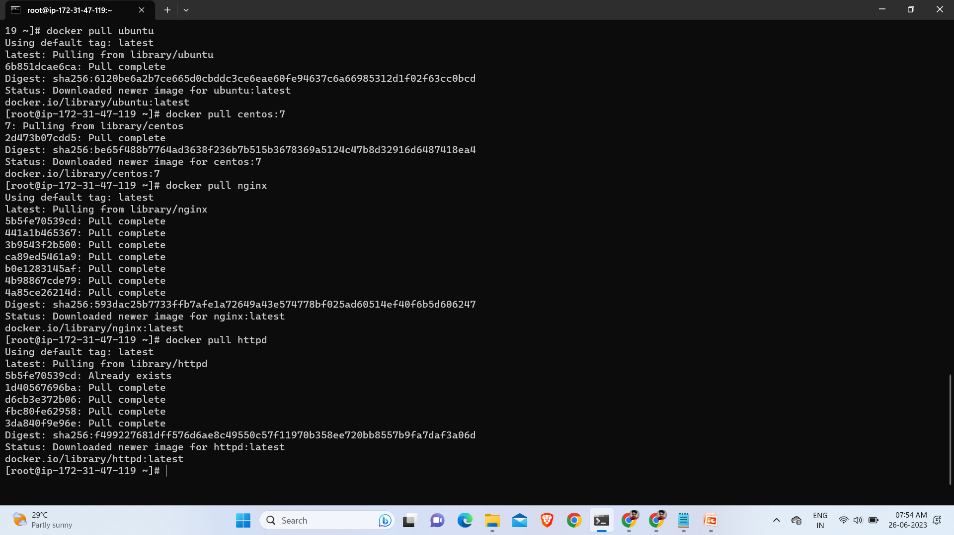
docker pull ubuntu :- it will downloads images of ubuntu .
docker pull centos:7 :- it will downloads images of centos:7.
docker pull nginx :- it will downloads images of nginx.
docker pull httpd :- it will downloads images of httpd.

Slide 11
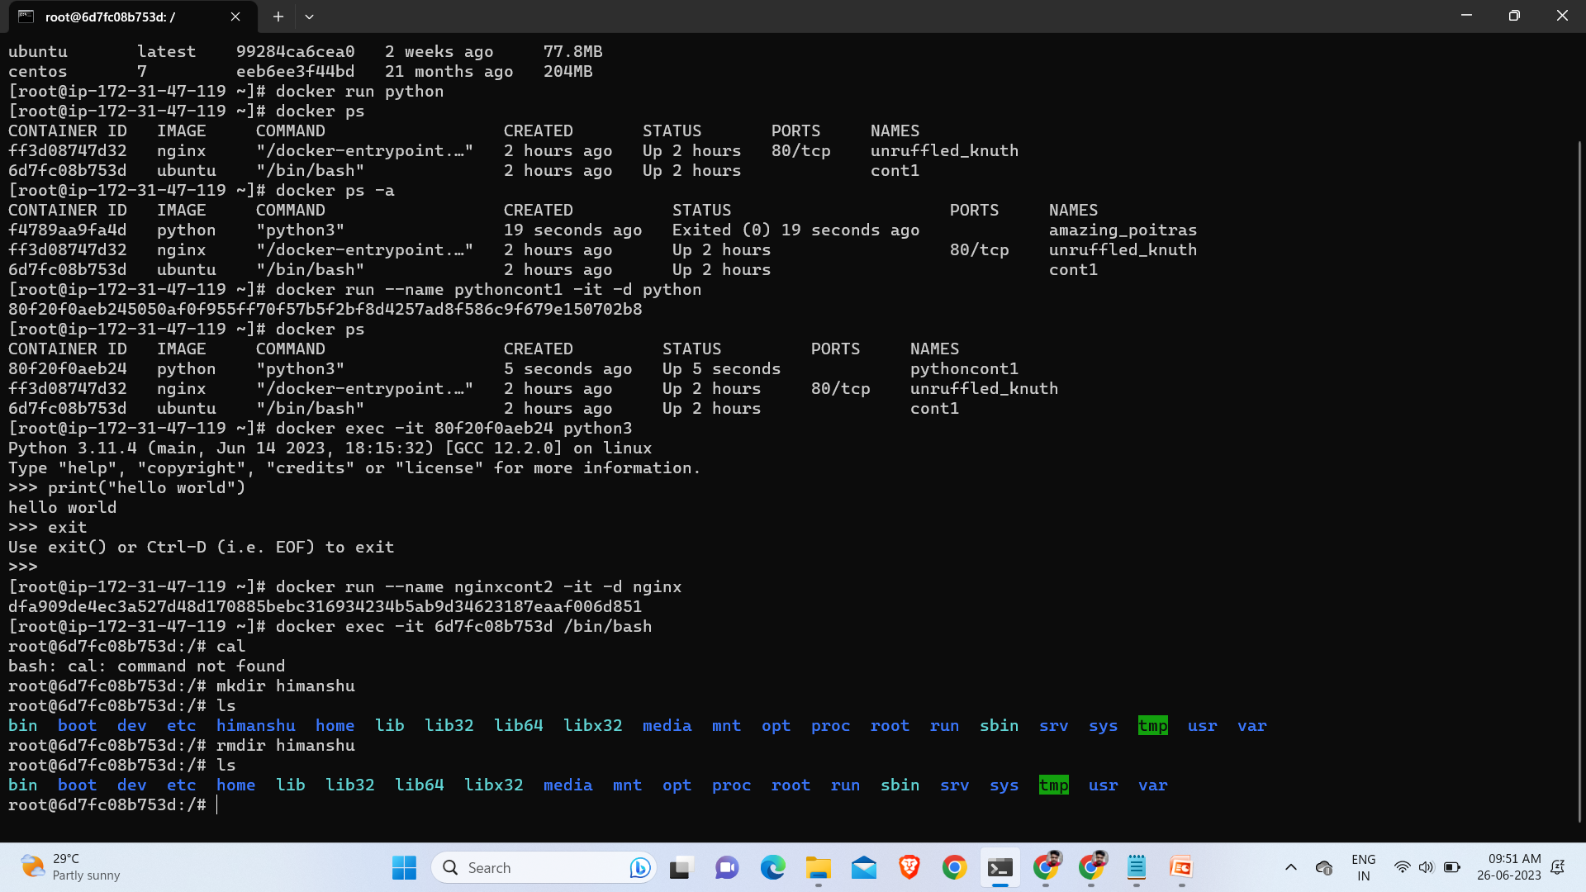
docker images :- to see all your pulled images.
docker ps :- to see your runing images.
docker ps -a :- to see all running as well as exited image.
docker run --name cont1 -it -d ubuntu :- to run the image.
docker exec -it CONTAINER ID COMMAND :- to in side the image.

Slide 12
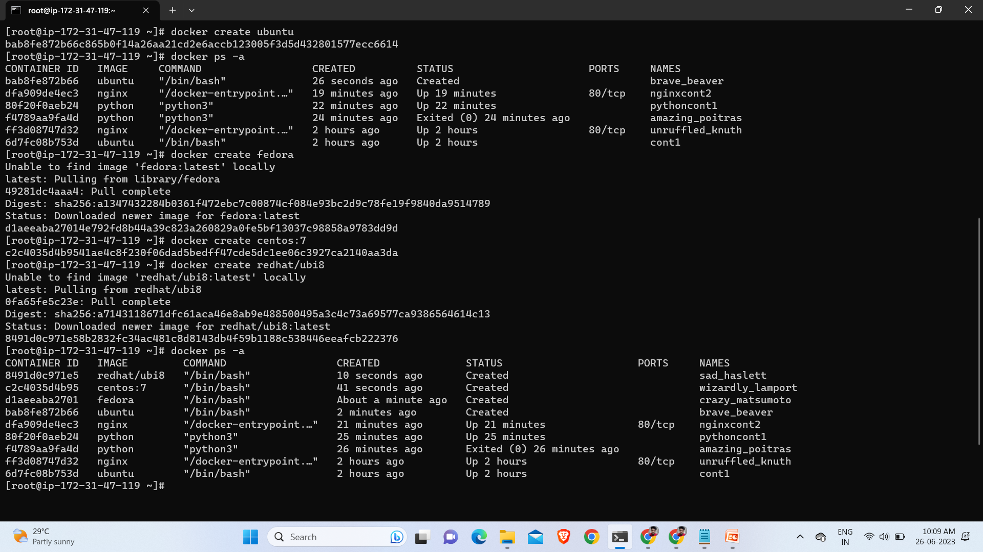
docker create ubuntu :- to create image ubuntu.
docker create fedora :-to create image fedora.
docker ps -a :- to chect image is created or not.

Slide 13
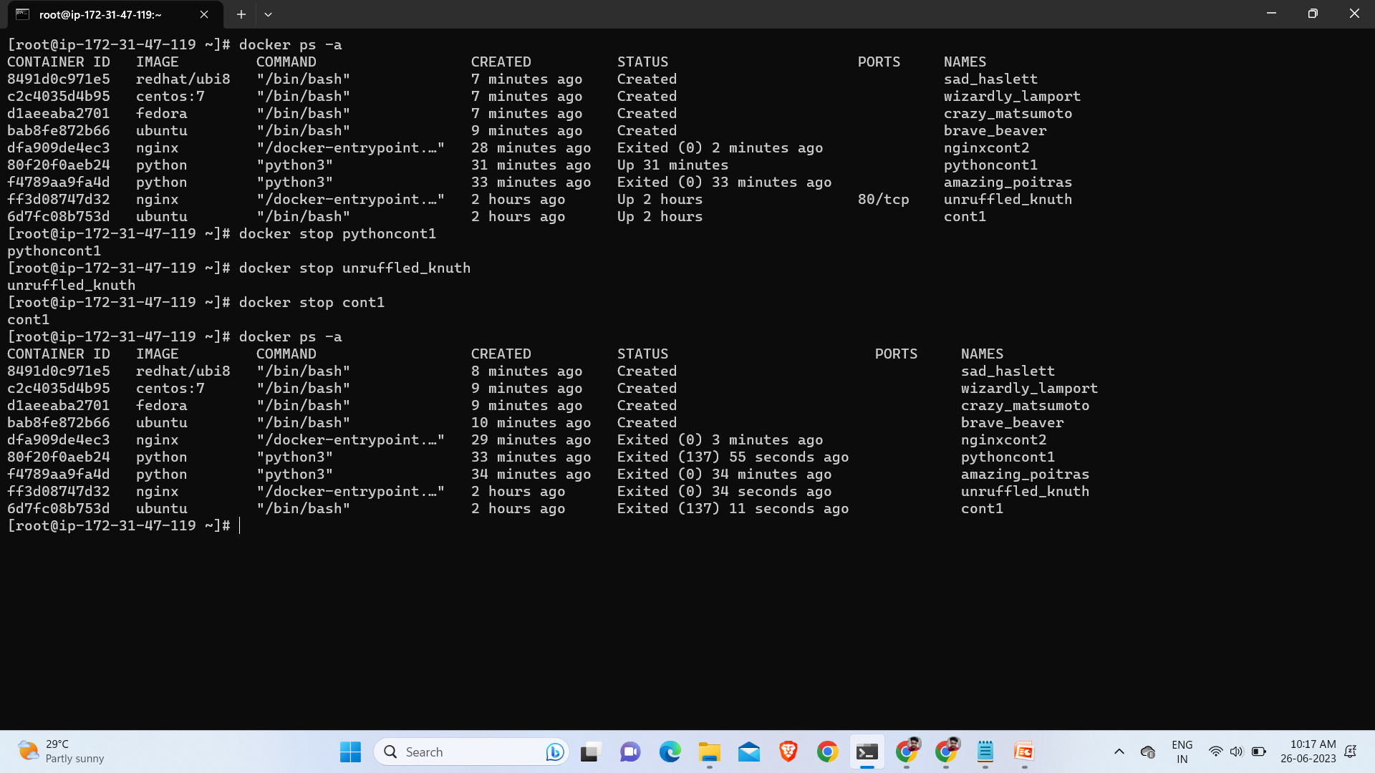
docker stop cont1 :- Now our cont1 goes under exited state.

Slide 14
Thank You….

